Slide 1
Objectives
In this session, you will learn to:
  Examine layout managers
  Describe the Swing single-threaded model
  Build a GUI using Swing components
  Define events and event handling
  Examine the Java SE event model
  Describe GUI behavior
  Determine the user action that originated an event
  Develop event listeners
  Describe concurrency in Swing-based GUIs and describe the features of the SwingWorker class
  Describe how to construct a menu bar, menu, and menu items in a Java GUI
  Understand how to change the color and font of a component
Notes:
Share the session objectives with the students.

Slide 2
Layout Managers
Layout manager:
  Determines the size and position of the components within a container.
  Positions the components according to a predetermined policy.

Slide 3
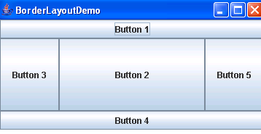
The BorderLayout Layout Manager
The BorderLayout layout manager:
  Arranges the components in five different regions: CENTER, NORTH, SOUTH, EAST, and WEST.
  Limits the number of components to be added, to each region, to one.
  Is the default layout for JFrame, JDialog, and JApplet.
The following figure displays an example of BorderLayout layout manager.

Slide 4
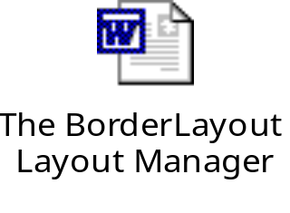
The BorderLayout Layout Manager (Contd.)
Let us understand the concept of BorderLayout layout manager by using the embedded document.

Slide 5
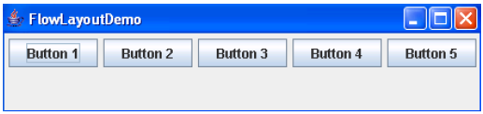

The FlowLayout Layout Manager
The FlowLayout layout manager:
  Arranges the components in a row.
  Arranges the components from LEFT_TO_RIGHT by default.
The following figure displays the example of FlowLayout layout manager.
Let us understand the concept of FlowLayout layout manager by using the embedded document.

Slide 6
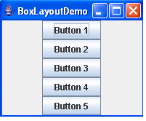
The BoxLayout Layout Manager
The BoxLayout layout manager:
  Arranges the components either vertically or horizontally.
  Constructor takes a parameter called axis, where the direction to align the components should be specified.
The following figure displays an example of BoxLayout layout manager.

Slide 7
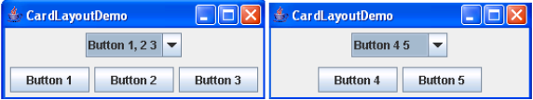
The CardLayout Layout Manager
The CardLayout layout manager:
  Arranges the components as a stack of cards.
  Accepts a single component for display. By making this single component a container, you can display multiple components in a card.
The following figures display an example of CardLayout layout manager.

Slide 8
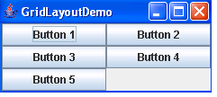

The GridLayout Layout Manager
The GridLayout layout manager arranges the components in rows and columns.
Each component occupies the same amount of space in the container.
The following figure displays an example of GridLayout layout manager.
Let us understand the concept of GridLayout layout manager by using the embedded document.

Slide 9
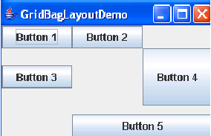
The GridBagLayout Layout Manager
The GridBagLayout layout manager arranges the components in rows and columns, similar to grid layout.
It provides a wide variety of flexibility options for resizing and positioning the components.
The following figure displays an example of the GridBagLayout layout manager.

Slide 10
The GroupLayout Layout Manager
The GroupLayout layout manager is used in the NetBeans IDE GUI builder tool.

Slide 11
Demo: Creating a Swing GUI Application
Let us see the demonstration of creating a Swing GUI application.
Notes:
You need to give the demonstration of demo provided at the following path:
TIRM\Datafiles_For_Faculty\demos\12_gui\exercise1\ChatRoomPrj

Slide 12
GUI Construction
A Java technology GUI can be created using either of the following techniques:
  Programmatic construction:
    Uses code to create the GUI.
    Is very laborious for use in production environments.
  Construction using a GUI builder tool:
    Uses a GUI builder tool to create the GUI.
    Uses a visual approach to drag-and-drop containers and components to a work area.

Slide 13
What Is an Event?
When the user performs an action at the user interface level (clicks a mouse or presses a key), this causes an event to be issued.
Events:
  Are objects that describe what has happened.
  Consist of various event classes to describe different categories of user action.
Event source:
  Is the generator of an event.
  Contains information about the events that just took place.
An event handler is a method that receives an event object, deciphers it, and processes the user’s interaction.

Slide 14
Delegation Model
The delegation event model came into existence with JDK version 1.1. With this model, events are sent to the component from which the event originated.
Listeners:
  Are classes that implement the EventListener interface.
  Contain event handlers that receive and process the event.

Slide 15
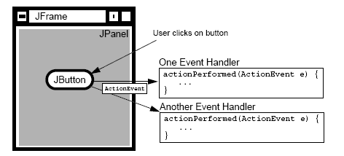
Delegation Model (Contd.)
The following figure displays an event delegation model.

Slide 16
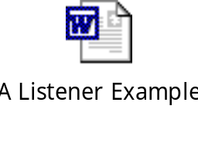
A Listener Example
Let us understand the concept of listeners by using the embedded document.

Slide 17
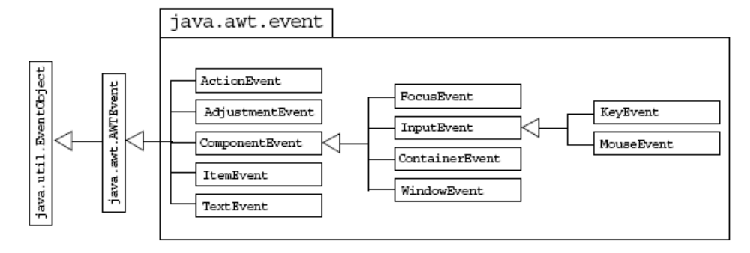
Event Categories
The events are arranged in form of categories, and reside in form of an hierarchy.
For each category of events, an interface has to be implemented by the class of objects that wants to receive the events.
The following figure displays the hierarchy of event categories.

Slide 18
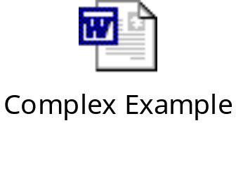
Complex Example
Let us understand how to use the mouse events by using the embedded document.

Slide 19
Multiple Listeners
The AWT event listening framework permits the attachment of multiple listeners to the same component.
The listener mechanism enables you to call an addXxxListener() method as many times as needed, and you can specify as many different listeners as your design requires.
All registered listeners have their handler methods called when the event occurs.

Slide 20
Event Adapters
It is very tedious to implement all of the methods in each of the listener interfaces, particularly the MouseListener interface and WindowListener interface.
The Java programming language provides adapter classes that implement each interface containing more than one method.
The methods in these adapter classes are empty.
You can extend an adapter class and override only those methods that you need.

Slide 21

Event Handling Using Inner Classes
Let us understand how to create event handlers as inner classes by using the embedded document.

Slide 22

Event Handling Using Anonymous Classes
Let us understand how to create event handlers as anonymous classes by using the embedded document.

Slide 23
Demo: Event Handling
Let us see the demonstration of handling an event.
Notes:
You need to give the demonstration of demo provided at the following path:
TIRM\Datafiles_For_Faculty\demos\13_events\exercise1\ChatRoomPrj

Slide 24
How to Create a Menu?
A Jmenu component is different from other components because you cannot add a JMenu component to ordinary containers and have them laid out by the layout manager.
Menus can be added only to a menu container.

Slide 25
Creating a JMenuBar
A JMenuBar component is a horizontal menu and can be add it to a JFrame object only.
It forms the root of all menu trees.
A JFrame displays one JMenuBar component at a time.
The following code snippet displays how to create a JMenuBar:
  f = new JFrame("JMenuBar");
  mb = new JMenuBar();
  f.setJMenuBar(mb);

Slide 26
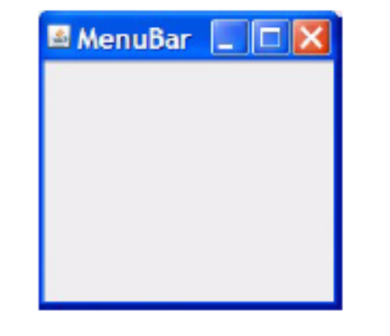
Creating a JMenuBar (Contd.)
The following figure displays a sample JMenuBar component.

Slide 27
Creating a JMenu
The JMenu component provides a basic pull-down menu and can be added either to a JMenuBar or to another JMenu.
The following code snippet displays how to create a JMenu:
    f = new JFrame("Menu");
    mb = new JMenuBar();
    m1 = new JMenu("File");
    m2 = new JMenu("Edit");
    m3 = new JMenu("Help");
    mb.add(m1);
    mb.add(m2);
    mb.add(m3);
    f.setJMenuBar(mb);

Slide 28
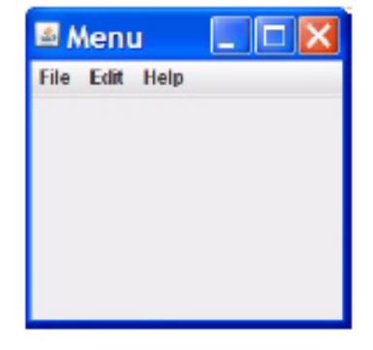
Creating a JMenu (Contd.)
The following figure displays a sample JMenu component.

Slide 29
Creating a JMenuItem
The JMenuItem components are the text leaf nodes of a menu tree. They are added to a menu to complete it.
The following code snippet displays how to create a JMenuItem:
  mi1 = new JMenuItem("New");
  mi2 = new JMenuItem("Save");
  mi3 = new JMenuItem("Load");
  mi4 = new JMenuItem("Quit");
  mi1.addActionListener(this);
  mi2.addActionListener(this);
  mi3.addActionListener(this);
  mi4.addActionListener(this);
  m1.add(mi1);
  m1.add(mi2);

Slide 30
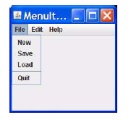
Creating a JMenuItem (Contd.)
  m1.add(mi3);
  m1.addSeparator();
  m1.add(mi4);
  m1.add(mi1);
  m1.add(mi2);
  m1.add(mi3);
  m1.addSeparator();
  m1.add(mi4);
The following figure displays a sample JMenuItem component.

Slide 31
Creating a JCheckboxMenuItem
The JCheckboxMenuItem is a checkable menu item, so you can have selections (on or off choices) listed in menus.
The following code snippet displays how to create a JCheckboxMenuItem:
  f = new JFrame("CheckboxMenuItem");
  mb = new JMenuBar();
  m1 = new JMenu("File");
  m2 = new JMenu("Edit");
  m3 = new JMenu("Help");
  mb.add(m1);
  mb.add(m2);
  mb.add(m3);
  f.setJMenuBar(mb);

Slide 32
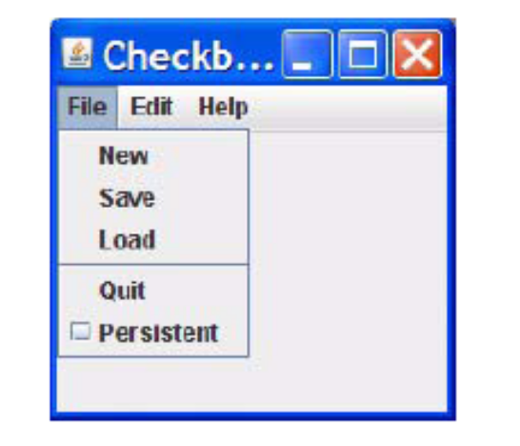
Creating a JCheckboxMenuItem (Contd.)
  ...........
  mi5 = new JCheckBoxMenuItem("Persistent");
  mi5.addItemListener(this);
  m1.add(mi5);
The following figure displays a sample JCheckBoxMenuItem component.

Slide 33
Demo: Adding Menus to the Container Components
Let us see the demonstration of adding menus to the container components.
Notes:
You need to give the demonstration of demo provided at the following path:
TIRM\Datafiles_For_Faculty\demos\13_guiapps\exercise1\ChatRoomPrj

Slide 34
Controlling Visual Aspects
The two methods used to set the colors of a component are:
  setForeground()
  setBackground()
A Color object can also be constructed by specifying the combination of three byte-sized integers (0–255), one for each primary color:
  Red
  Blue
  Green

Slide 35
Summary
In this session, you learned that:
  Layout manager:
    Determines the size and position of the components within a container.
    Positions the components according to a predetermined policy.
  The BorderLayout layout manager:
    Arranges the components in five different regions: CENTER, NORTH, SOUTH, EAST, and WEST.
  The FlowLayout layout manager:
    Arranges the components in a row.
    Arranges the components from LEFT_TO_RIGHT by default.
  The BoxLayout layout manager:
    Arranges the components either vertically or horizontally.
    Constructor takes a parameter called axis, where the direction to align the components should be specified.

Slide 36
Summary (Contd.)
  The CardLayout layout manager:
    Arranges the components as a stack of cards.
    Accepts a single component for display.
  The GridLayout layout manager arranges the components in rows and columns.
  The GroupLayout layout manager is used in the NetBeans IDE GUI builder tool.
  A Java technology GUI can be created using either of the following techniques:
    Programmatic construction
    Construction using a GUI builder tool
  Events:
    Are objects that describe what has happened.
    Consist of various event classes to describe different categories of user action.
  An event handler is a method that receives an event object, deciphers it, and processes the user’s interaction.

Slide 37
Summary (Contd.)
  Listeners:
    Are classes that implement the EventListener interface
    Contain event handlers that receive and process the event.
  The Java programming language provides adapter classes that implement each interface containing more than one method.
  Menus can be added only to a menu container.
  A JMenuBar component is a horizontal menu and can be add it to a JFrame object only.
  The JMenu component provides a basic pull-down menu and can be added either to a JMenuBar or to another JMenu.
  The following two methods used to set the colors of a component are:
    setForeground()
    setBackground()

